Slide 1
PET Examination OVERVIEW
John Scullion
Guadalajara

Slide 2
Overview
Cambridge English: Preliminary, also known as Preliminary English Test (PET), is an intermediate level qualification.
It shows you are able to use your English language skills for work, study and travel.

Slide 3
Paper | Content | Time | Weighting
Reading & Writing | Reading has 5 parts/35 questions; Writing has 3 parts/7 questions. | 1 hour 30 minutes | 50%
Listening | 4 parts/25 questions | About 30 minutes (inc. 6 minutes' transfer time) | 25%
Speaking | 4 parts | 10-12 minutes per pair | 25%

Slide 4
Paper 1 Reading/Writing
1 hour 30 minutes
Reading
Five parts test a range of reading skills with a variety of texts, ranging from very short notices to longer continuous texts.
Writing
Three parts test a range of writing skills.
Assessment of candidates’ ability to understand the meaning of written English at word, phrase, sentence, paragraph and whole text level.
Assessment of candidates’ ability to produce straightforward written English, ranging from producing variations on simple sentences to pieces of continuous text.

Slide 5
Reading
Candidates should be able to understand public notices and signs; read short texts of a factual nature and show understanding of the content; demonstrate understanding of the structure of the language as it is used to express notions of relative time, space, possession, etc.; scan factual material for information in order to perform relevant tasks, disregarding redundant or irrelevant material; read texts of an imaginative or emotional character and appreciate the central sense of the text, the attitude of the writer to the material and the effect it is intended to have on the reader.

Slide 6
Writing
Candidates should be able to give information, report events, and describe people, objects and places as well as convey reactions to situations, express hopes, regrets, pleasure, etc.

Slide 7
Paper 2 Listening
30 minutes (approx.) 25 Questions
Four parts ranging from short exchanges to longer dialogues and monologues.
Assessment of candidates’ ability to understand dialogues and monologues in both informal and neutral settings on a range of everyday topics.

Slide 8
Listening
Candidates should be able to understand and respond to public announcements; to show precise understanding of short factual utterances and to make identifications on the basis of these; to extract information of a factual nature (times, dates, etc.) from speech which will contain redundancies and language outside the defined limits of PET; to understand the sense of a dialogue and show appreciation of the attitudes and intentions of the speakers.

Slide 9
Process
Candidates indicate answers either by shading lozenges (Parts 1, 2 and 4) or writing answers (Part 3) on an answer sheet.
Candidates record their answers on the question paper as they listen.
They are then given 6 minutes at the end of the test to copy these on to the answer sheet.

Slide 10
Process continued
Each text is heard twice. Recordings information will contain a variety of accents corresponding to standard variants of native speaker accents.
Marking Each item carries one mark. This gives a total of 25 marks, which represents 25% of total marks for the whole examination.

Slide 11
Paper 3 Speaking
10–12 minutes per pair of candidates
Four parts. In Part 1, candidates interact with an examiner. In Parts 2 and 4 they interact with another candidate. In Part 3, they have an extended individual long turn.
Assessment of candidates’ ability to express themselves in order to carry out functions at Threshold level. To ask and to understand questions and make appropriate responses. To talk freely on matters of personal interest.

Slide 12
Speaking
Candidates should be able to express themselves in order to fulfil the functions listed in the Syllabus in situations which simulate authentic communication. They should be able to ask and to understand questions and make appropriate responses, and should be able to talk freely in order to express emotions, reactions, etc.

Slide 13
GENERAL DESCRIPTION
Paper format The paper contains four parts.
Timing 10–12 minutes per pair of candidates.
Interaction The standard format is two pattern candidates and two examiners.
One examiner acts as both assessor and interlocutor and manages the interaction by asking questions and setting up the tasks. The other acts as assessor and does not join in the conversation.
Task types Short exchanges with the interlocutor; a collaborative task involving both candidates; a 1- minute long turn and a follow up discussion.
Marks Candidates are assessed on their performance throughout the test.
There are a total of 25 marks for Paper 3, making 25% of the total score for the whole examination.

Slide 14
Part 1
Each candidate interacts with the interlocutor.
The interlocutor asks the candidates questions in turn, using standardised questions.
Focus Giving information of a factual, personal kind.
The candidates respond to questions about present circumstances, past experiences and future plans.
Timing 2–3 minutes.

Slide 15
Part 2
Task type Simulated situation. Candidates interact with and format each other.
Visual stimulus is given to the candidates to aid the discussion task. The interlocutor sets up the activity using a standardised rubric.
Focus Using functional language to make and respond to suggestions, discuss alternatives, make recommendations and negotiate agreement.
Timing 2–3 minutes.

Slide 16
Part 3
Task type Extended turn.
A colour photograph is given to each candidate in turn and they are asked to talk about it for approximately a minute. Both photographs relate to the same topic.
Focus Describing photographs and managing discourse, using appropriate vocabulary, in a longer turn.
Timing 3 minutes.

Slide 17
Part 4
Task type General conversation. Candidates interact witheach other.
The topic of the conversation develops the theme established in Part 3.
The interlocutor sets up the activity using a standardised rubric.
Focus The candidates talk together about their opinions, likes/dislikes, preferences, experiences, habits, etc.
Timing 3 minutes.

Slide 18
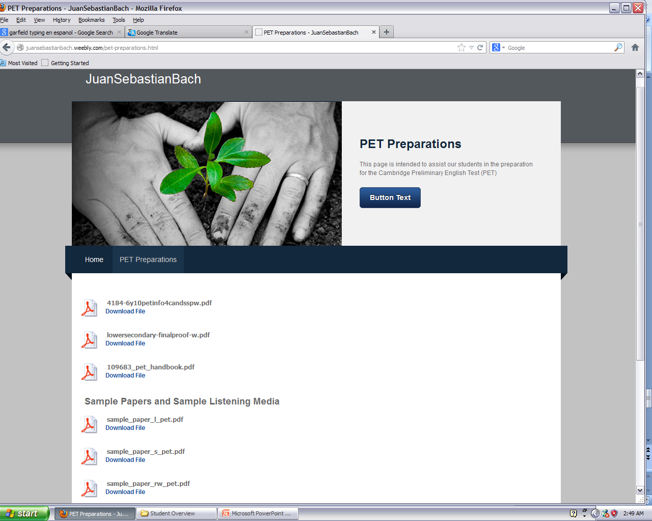
http://juansebastianbach.weebly.com/index.html

Slide 19
Intended Schedule
Wednesday Mock Exam
Friday Parents’ meeting
Inscription Deadline 15th March
Application 18th May 2013

Slide 20
Any questions?
http://www.cambridgeenglish.org/exams-and-qualifications/preliminary/

